Slide 1
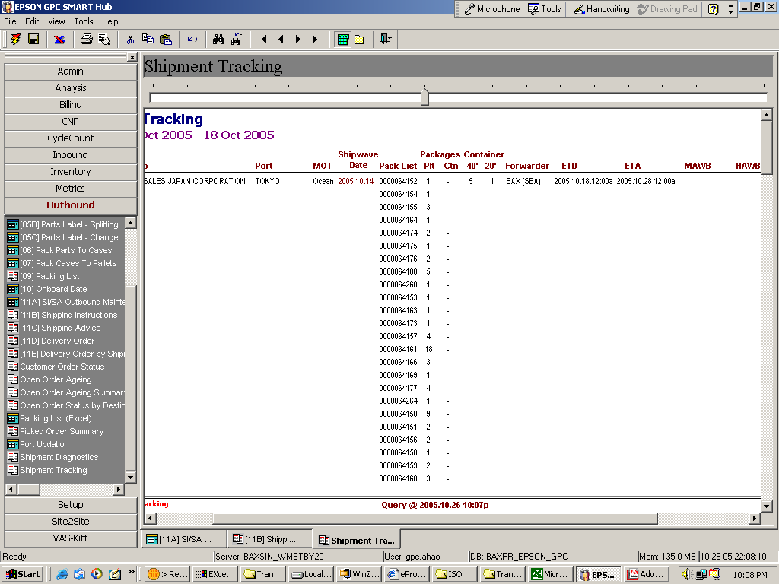
Peifong, one more request -- the wave no. is not in sequence within same shipwave date – pls help

